Slide 1



Land Record Management System using Blockchain
Supervisor: Mr. Adnan Bashir
Co-supervisor: Ihsan Elahi Butt (Systems Limited)
Fareed Ul Hassan (Nestsol)
Group Members:
Jawad Ahmed
Sharjeel Akram
Mian Muhammad Zubair

Slide 2
Agenda
Introduction
Problem Statement
Objective and Scope
Proposed System
Methodology
Technologies
Conclusion
Demo

Slide 3
Introduction
The significance of land record management in governance and socio-economic development.
Challenges faced by traditional land record systems, such as data inconsistencies and disputes.
Introduction to blockchain technology and its unique characteristics - decentralization, immutability, and transparency.
How blockchain can transform land record management by addressing existing challenges.
Overview of the key features and benefits of the LRMS using blockchain technology.
Setting the stage for a detailed exploration of the LRMS and its role in revolutionizing land record management.

Slide 4
Problem Statement
Traditional land record management solutions are inefficient and manual process, causing delays, data errors, and disagreements.
Landowners may have trouble getting accurate and current land ownership and transaction data from existing land record systems.
Landowners, buyers, and authorities distrust conventional land record systems due to data tampering and unauthorized access.
Land transactions can take long and include several middlemen, increasing expenses and delays.
Traditional land record systems may not resolve land disputes efficiently, resulting in lengthy judicial proceedings and chaos in society.

Slide 5
Objectives and Scope
Implement a Blockchain-Based Land Record Management System (LRMS) to maintain land record data integrity and immutability.
Smart contracts automate land transfers and remove middlemen for faster, more efficient transactions.
Landowners, buyers and Land Revenue Department will trust land record information if it is transparent and provide a fast dispute resolution system to help Department.
Administrators, landowners, buyers, and Land Authorities will have specialized permissions to ensure secure access and data confidentiality.
Create an easy-to-use LRMS interface and ensure fair access to land record information by designing the LRMS for rural areas with inadequate internet connectivity.

Slide 6
Proposed System
Creating a Blockchain-Based Land Record Management System (LRMS) to replace traditional ones tostore land records safely and transparently.
Smart contracts will automate land deals for efficiency and accuracy,
The proposed system will make land record data visible, building stakeholder trust.
The LRMS will offer an easy-to-use interface for users of all technical levels.
Integration with geolocation and payment gateway providers will improve the LRMS.

Slide 7
Technologies
Blockchain
Hyperledger Fabric
Back-end
Node.js
Express.js
Docker
XAMPP Server
Front-end
HTML
CSS
Embedded JavaScript
Flutter
Databases
MySQL
CouchDB

Slide 8
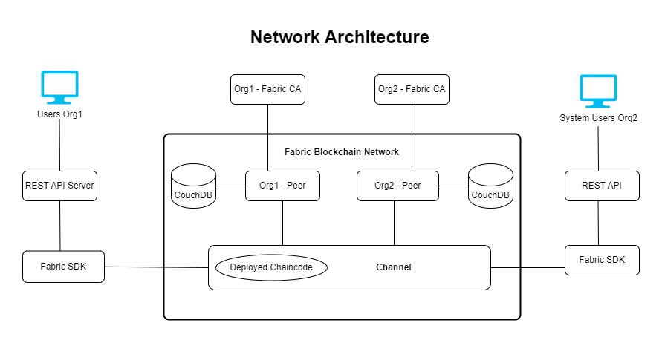
Methodology
Network Architecture Diagram

Slide 9
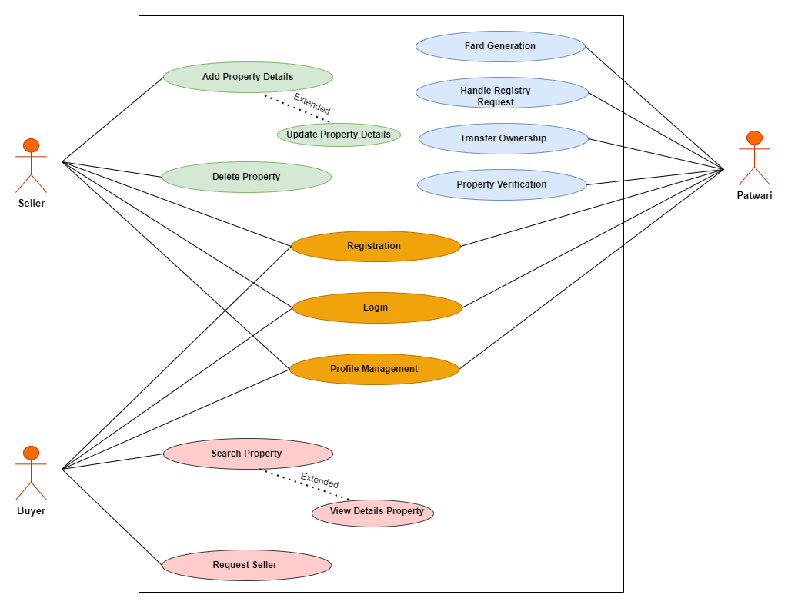
Use Case Diagram

Slide 10
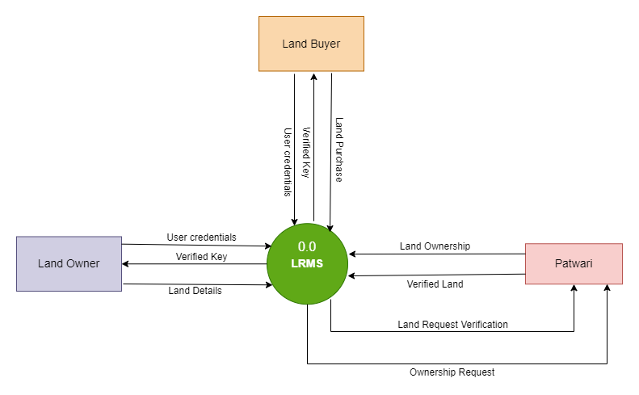
Data Flow Diagram
Level 0 DFD

Slide 11
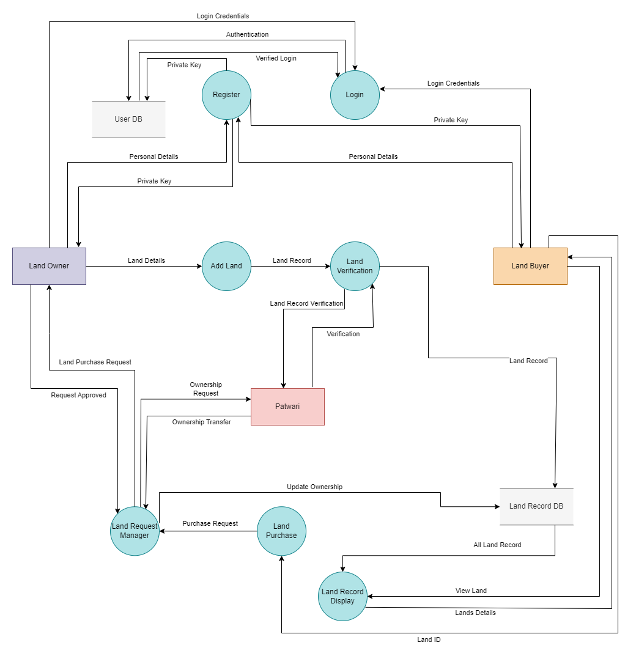
Data Flow Diagram
Level 1 DFD

Slide 12
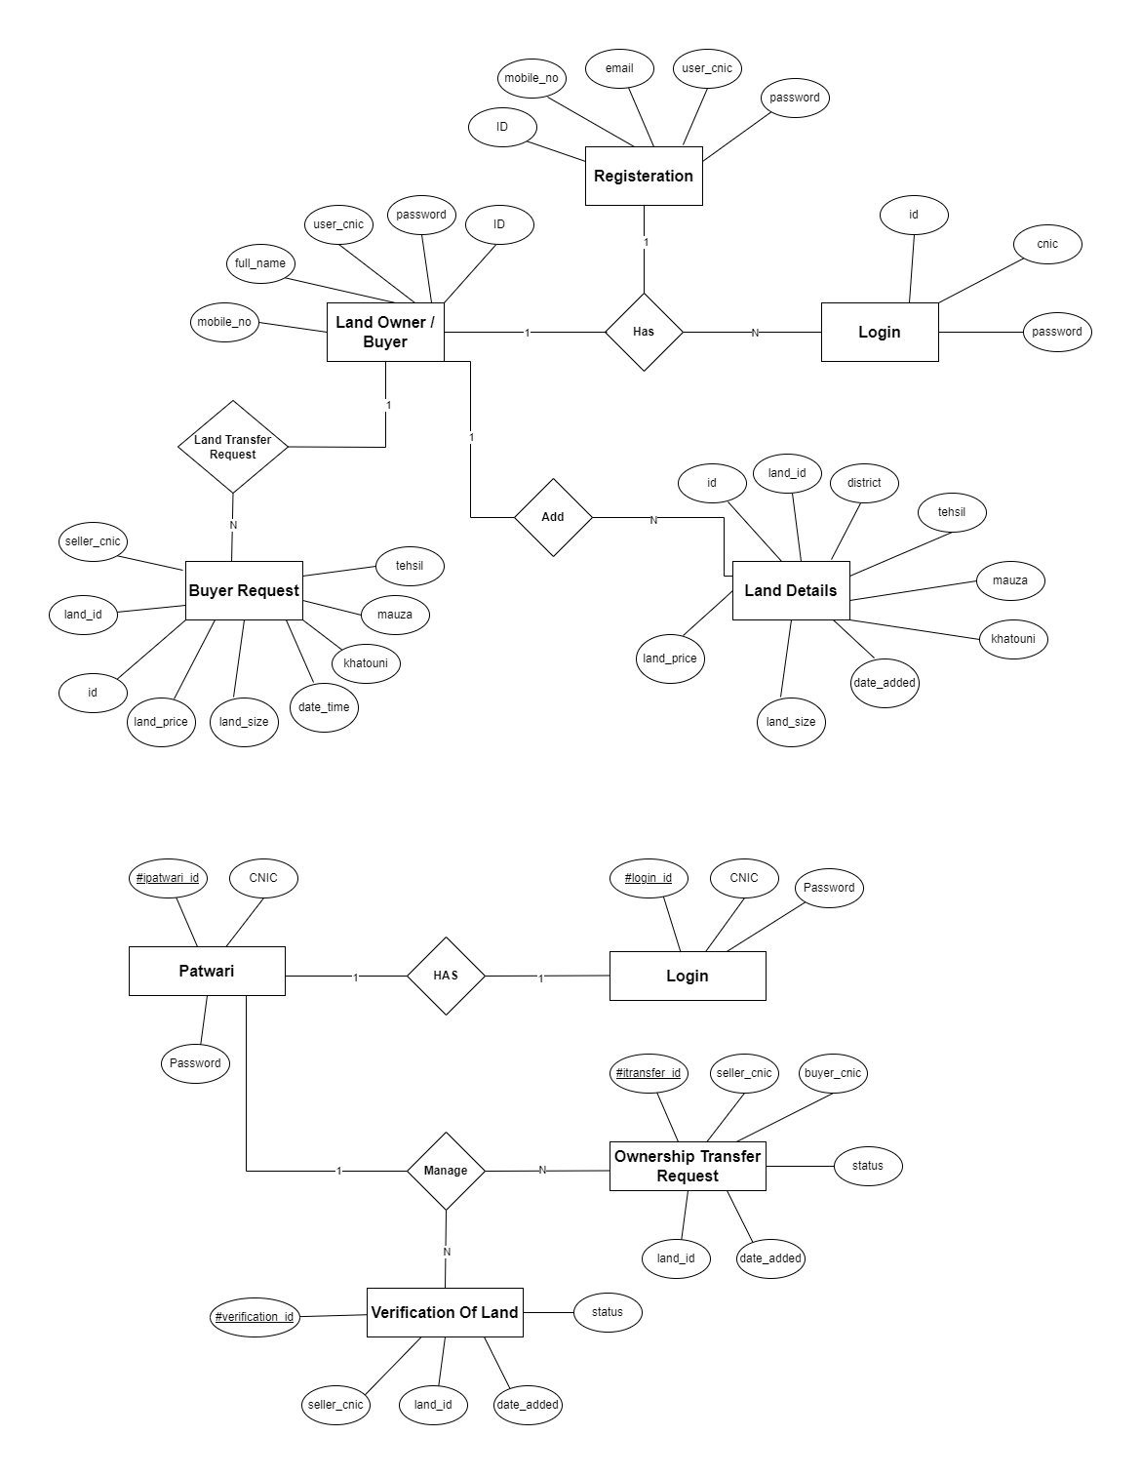
ER Diagram

Slide 13
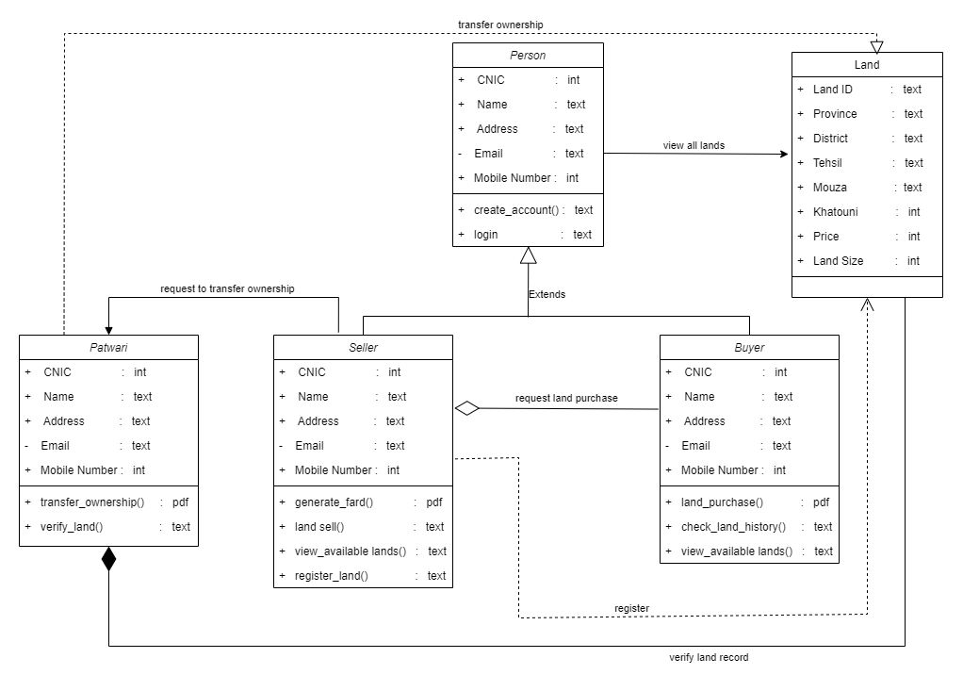
Class Diagram

Slide 14
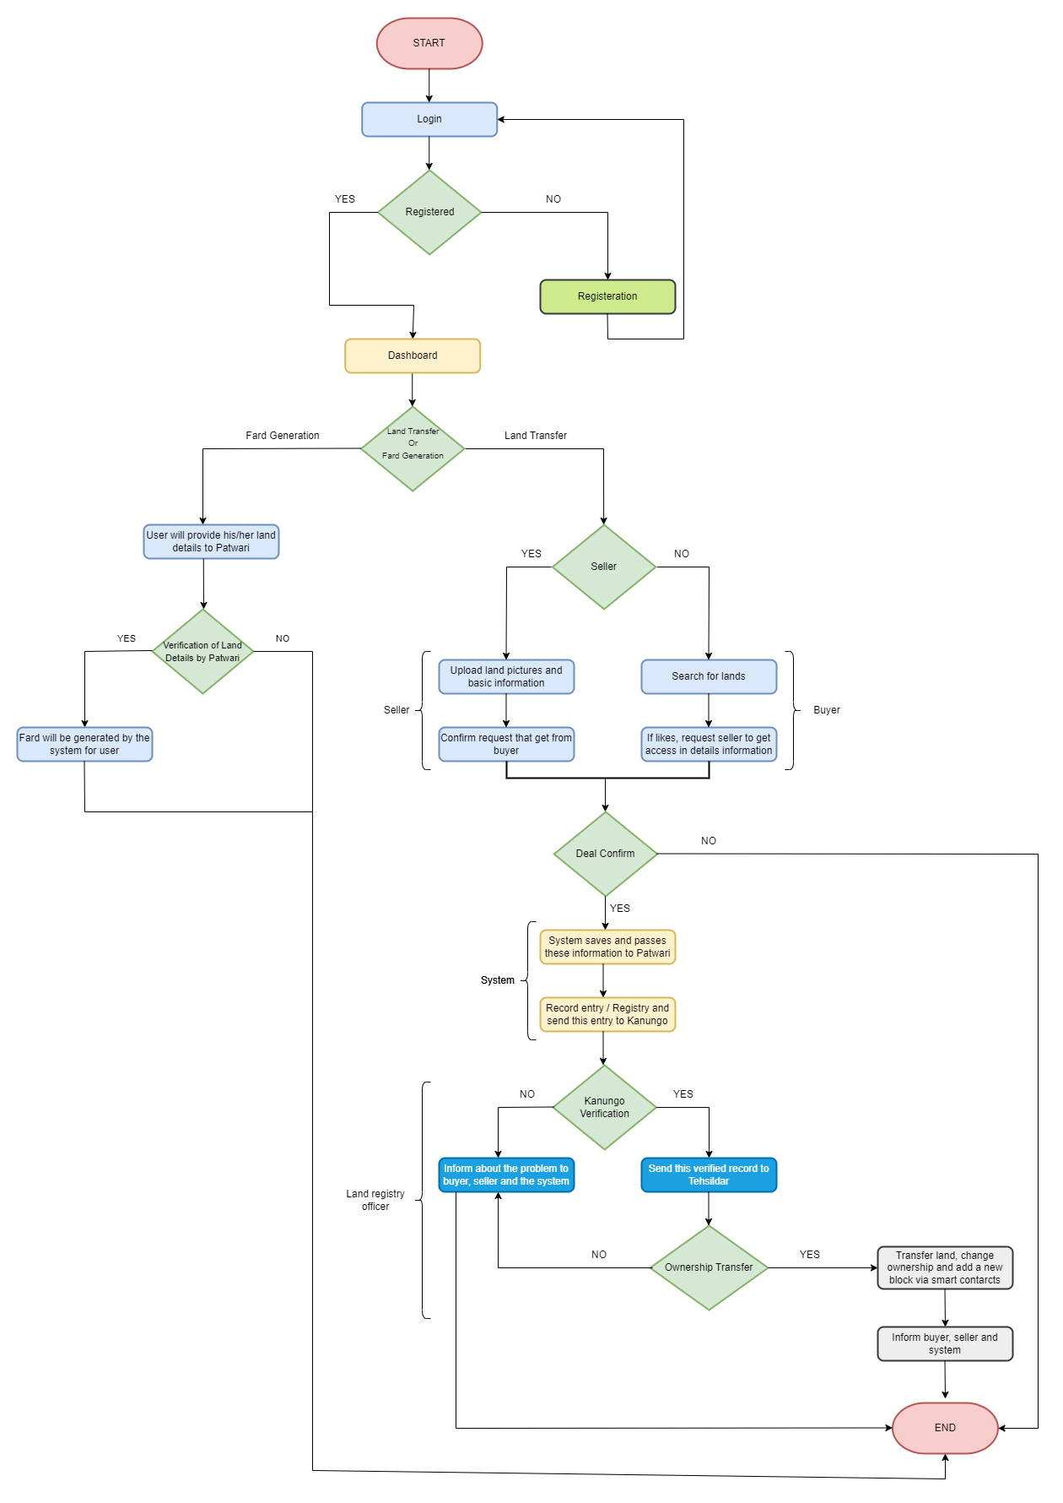
Flow Chart

Slide 15
Conclusion
The system has addressed prominent issues with land record transactions, like data integrity, transparency, and security, by utilizing blockchain technology.
Different components of land deals have been automated using smart contracts, expediting the procedure, and lowering dependency on intermediaries.
Now it is impossible to tamper with land records, offering a trustworthy source of information on ownership and transaction history.
The transparency that blockchain technology provides has increased stakeholder trust and stopped fraud and disagreements.

Slide 16
Future Work
Enhanced Reporting and Analytics
Integration with External Systems
Continuous Performance Optimization
Blockchain Network Scalability
Integration with AI (Artificial Intelligence) and Machine Learning

Slide 17



Demo

